Slide 1
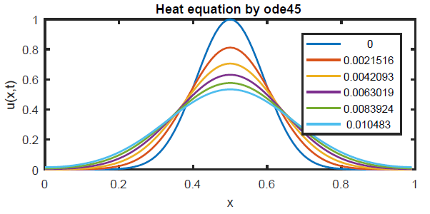
Chapter 11 Diffusion equations

Slide 2
Partial differential equations (PDEs)
In Chapter 5, we saw IVPs with data at one side of the domain and marching from that end (time like)
In Chapter 9, we saw BVPs with data at both ends of the domain (space like)
Both cases had only one independent variable
For PDEs, there are two independent variables
We start with one being time (like in an IVP) and one being space (like in a BVP)
Sometimes called initial boundary value problems (IBVPs)

Slide 3
Section 11.1 Black-Scholes equation

Slide 4
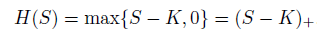
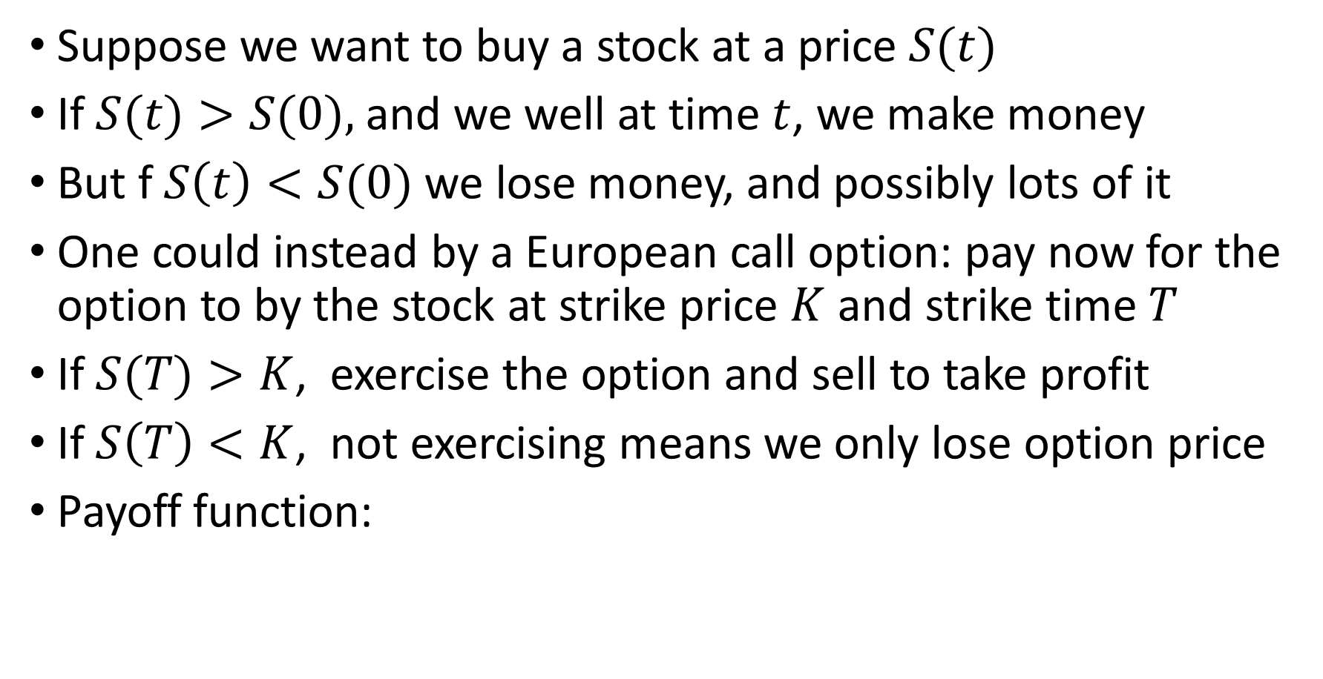
Black-Scholes equation
Suppose we want to buy a stock at a price $S(t)$
If $S(t)>S(0),$and we well at time $t$, we make money
But f $S\left(t\right)<S(0)$ we lose money, and possibly lots of it
One could instead by a European call option: pay now for the option to by the stock at strike price $K$ and strike time $T$
If $S(T)>K$, exercise the option and sell to take profit
If $S\left(T\right)<K$, not exercising means we only lose option price
Payoff function:

Slide 5
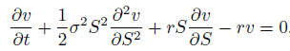
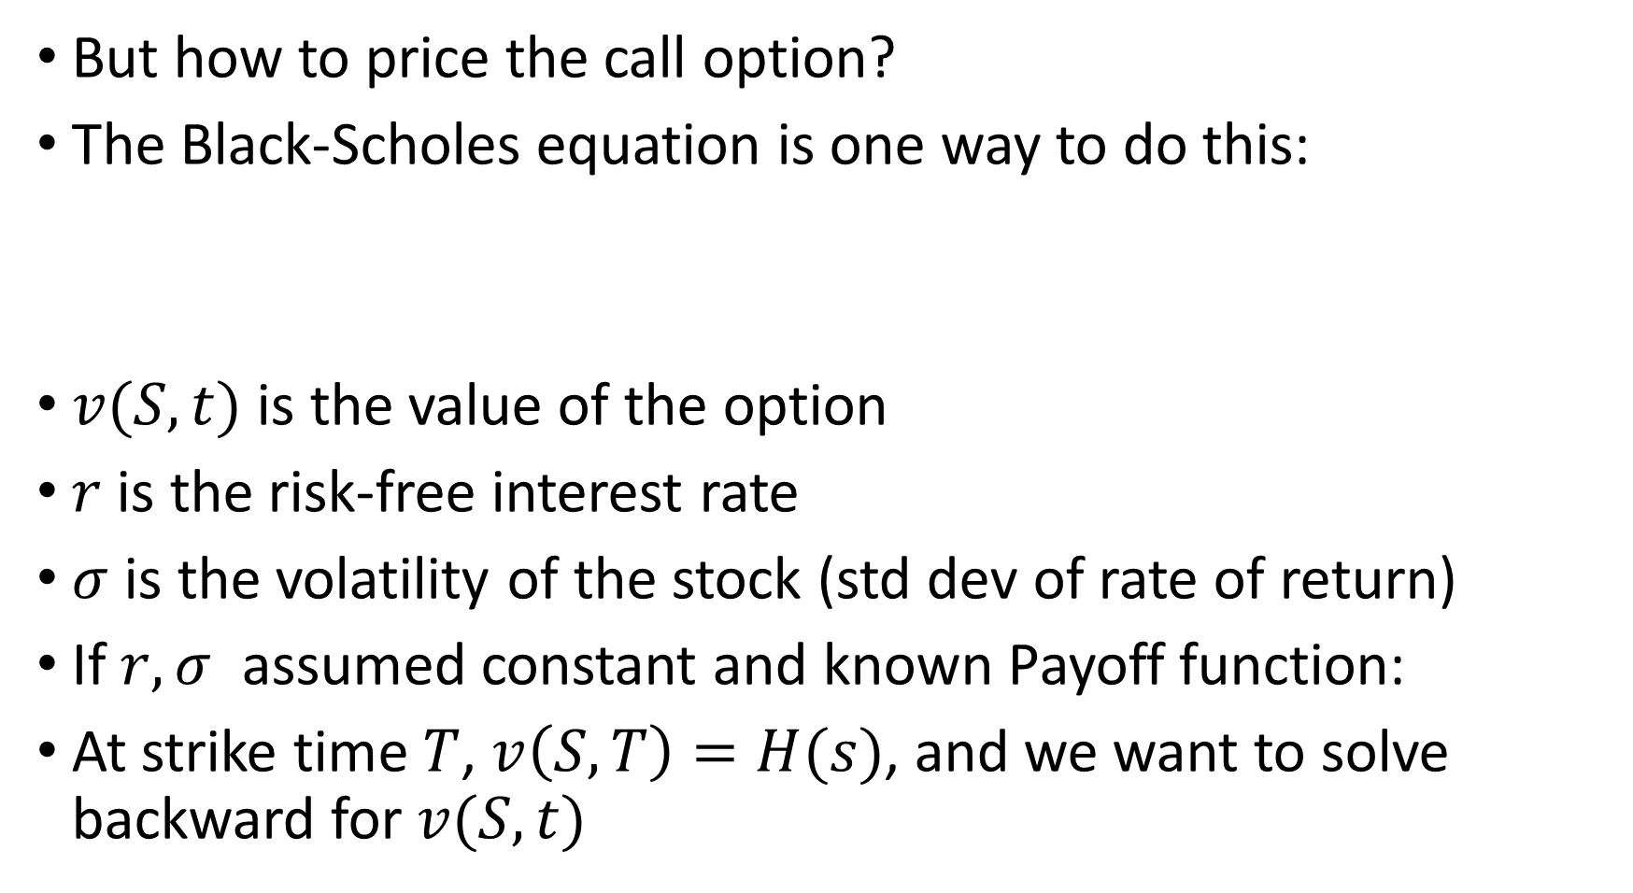
Black-Scholes equation
But how to price the call option?
The Black-Scholes equation is one way to do this:
$v(S,t)$ is the value of the option
$r$ is the risk-free interest rate
$σ$ is the volatility of the stock (std dev of rate of return)
If $r, σ$ assumed constant and known Payoff function:
At strike time $T$, $v\left(S,T\right)=H(s)$, and we want to solve backward for $v(S,t)$

Slide 6
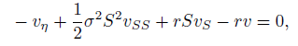
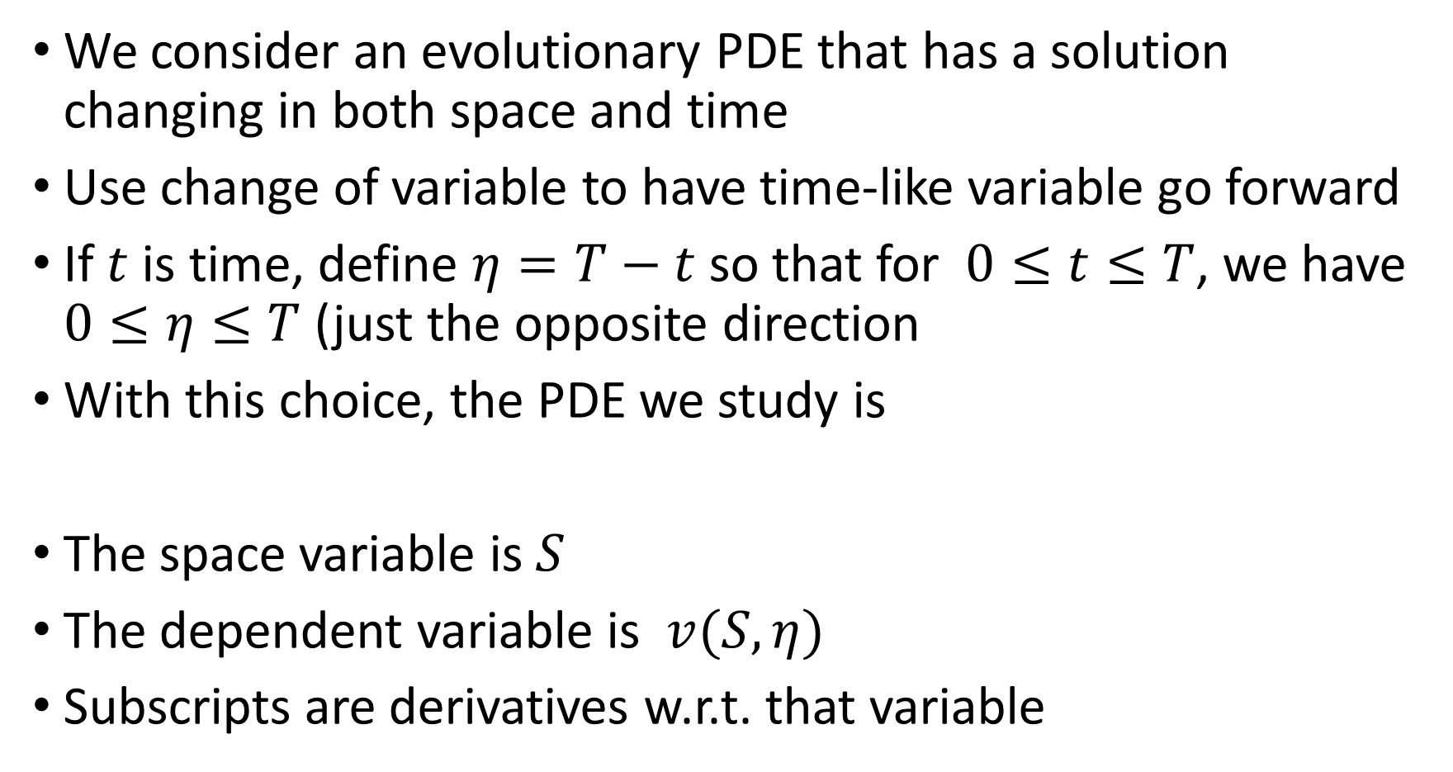
Black-Scholes equation
We consider an evolutionary PDE that has a solution changing in both space and time
Use change of variable to have time-like variable go forward
If $t$ is time, define $η=T−t$ so that for $0≤t≤T$, we have $0≤η≤T$ (just the opposite direction
With this choice, the PDE we study is
The space variable is $S$
The dependent variable is $v(S,η)$
Subscripts are derivatives w.r.t. that variable

Slide 7
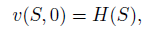
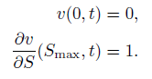
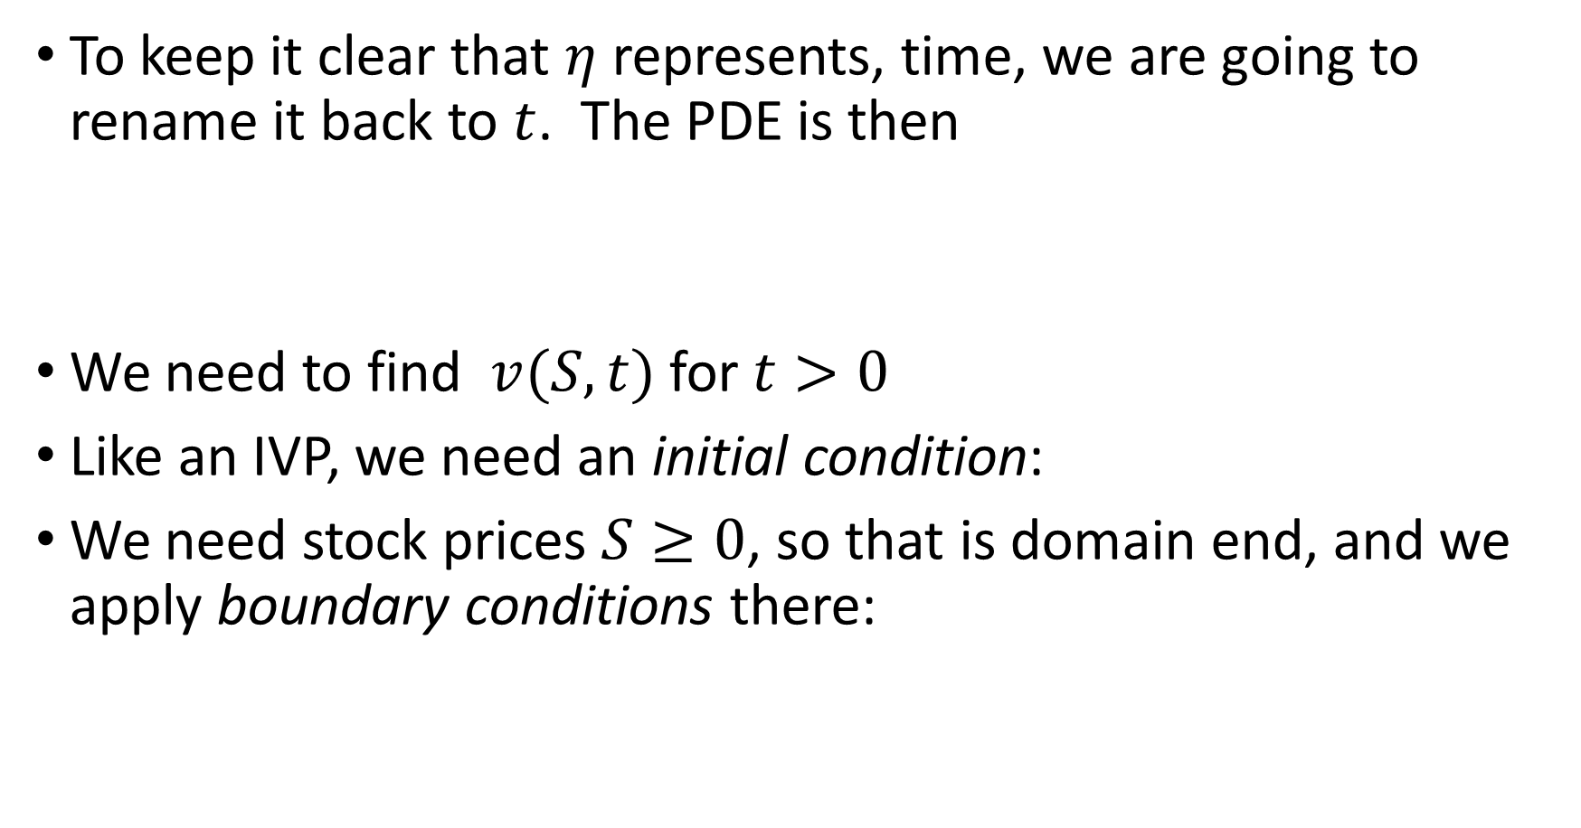
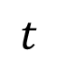
Black-Scholes equation
To keep it clear that $η$ represents, time, we are going to rename it back to $t$. The PDE is then
We need to find $v(S,t)$ for $t>0$
Like an IVP, we need an initial condition:
We need stock prices $S≥0$, so that is domain end, and we apply boundary conditions there:
$$t$$

Slide 8
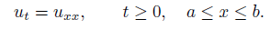
Diffusion equations
More changes of variables can simplify the problem
to having only
a first order time derivative and
a second order space derivative
The combination is essential for making this a heat or diffusion problem (in the original problem too)
For these kinds of problems, the solution gets smoothed out with time
The heat equation is

Slide 9
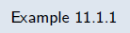
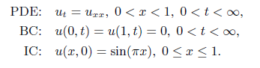
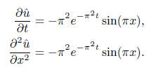
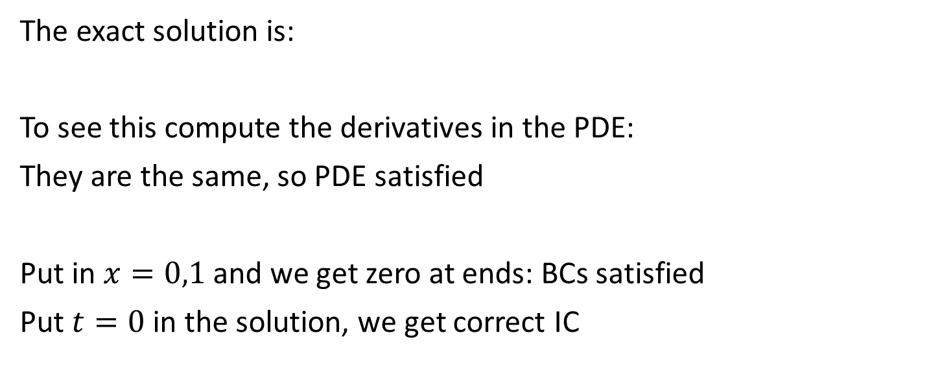
Example: heat equation
Verify simple exact solution for heat equation
The exact solution is:
To see this compute the derivatives in the PDE:
They are the same, so PDE satisfied
Put in $x=0,1$ and we get zero at ends: BCs satisfied
Put $t=0$ in the solution, we get correct IC

Slide 10
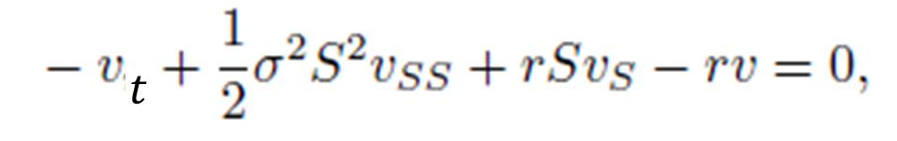
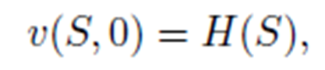
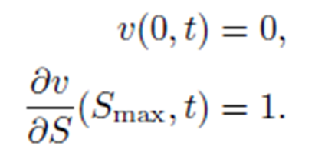
Numerical approach to Black-Scholes
Return to Black-Scholes and try a naïve numerical approach
The problem is
We set up nodes (a grid) and approximate the derivatives with finite differences
PDE:
ICs:
BCs:

Slide 11
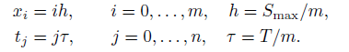
Numerical approach to Black-Scholes
The grid is given by
A function on this grid becomes the grid function V with
The IC becomes
Use a first-order forward difference in time and centered finite differences in space in PDE:

Slide 12
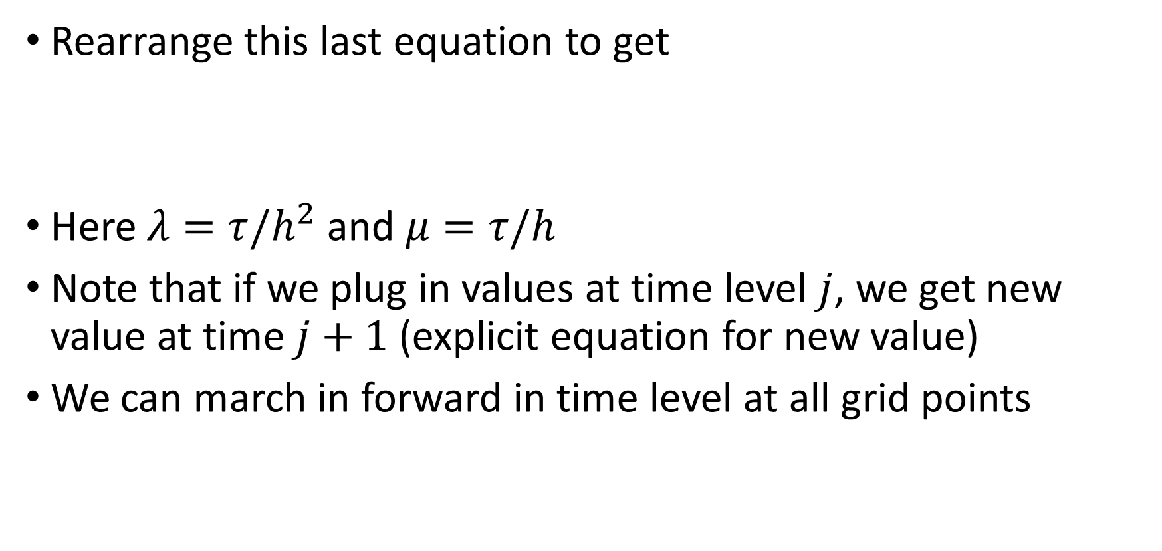
Numerical approach to Black-Scholes
Rearrange this last equation to get
Here $λ=τ/h^{2}$ and $μ=τ/h$
Note that if we plug in values at time level $j$, we get new value at time $j+1$(explicit equation for new value)
We can march in forward in time level at all grid points

Slide 13
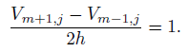
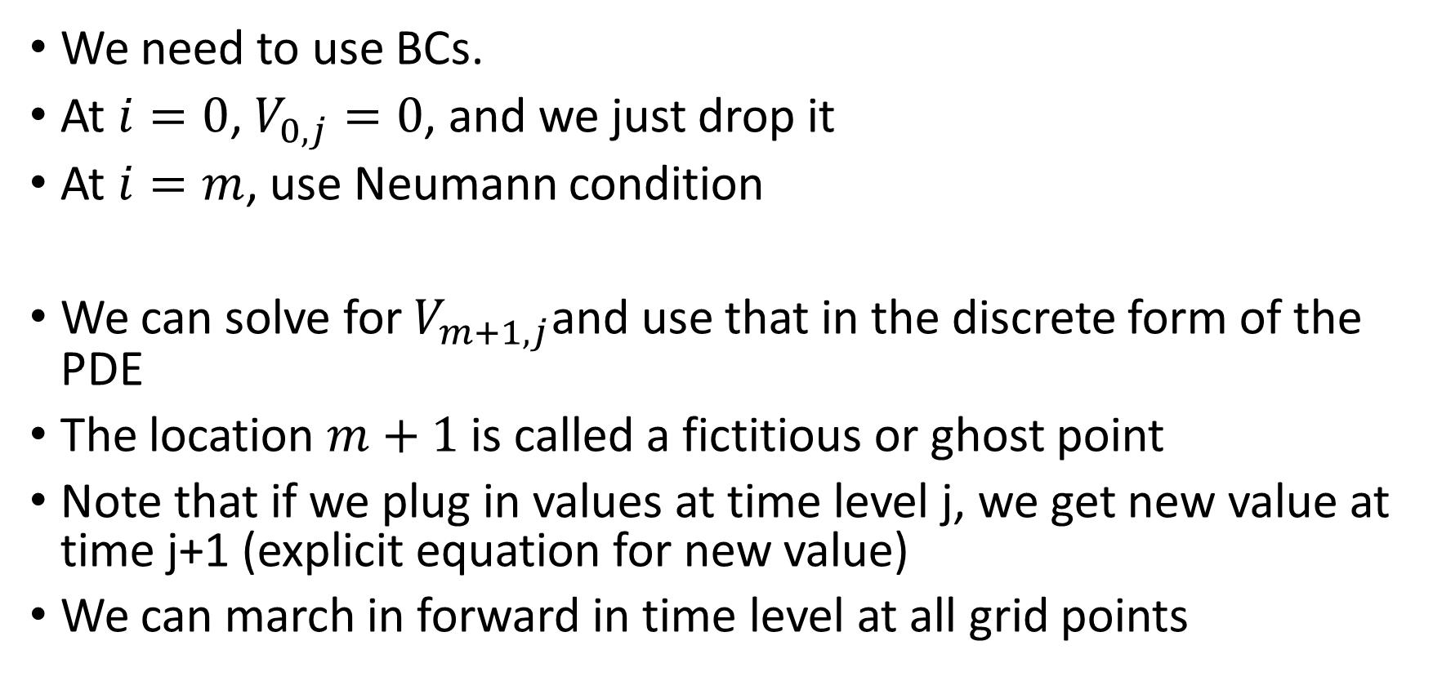
Numerical approach to Black-Scholes
We need to use BCs.
At $i=0$, $V_{0,j}=0$, and we just drop it
At $i=m$, use Neumann condition
We can solve for $V_{m+1,j}$and use that in the discrete form of the PDE
The location $m+1$ is called a fictitious or ghost point
Note that if we plug in values at time level j, we get new value at time j+1 (explicit equation for new value)
We can march in forward in time level at all grid points

Slide 14
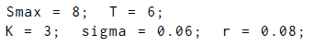
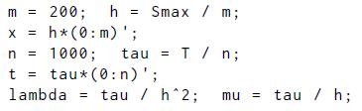
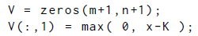
Example: Numerical solution of Black-Scholes
Use $σ=0.06, r=0.08, K=3, S_{max}=8$
Parameter set up
Space grid in x
Time grid in t
Numerical parameters
Preallocate
IC (pcwise linear)

Slide 15
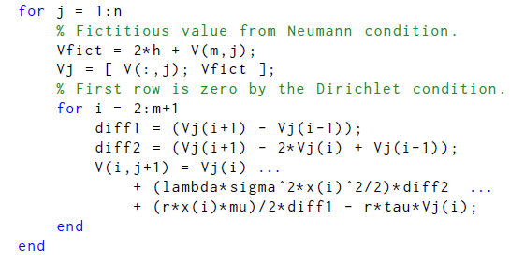
Example: Numerical solution of Black-Scholes
March forward in time
Outer loop advances time
Inner loop update all the x locations to get one new time level

Slide 16
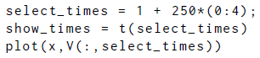
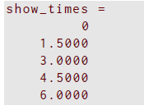
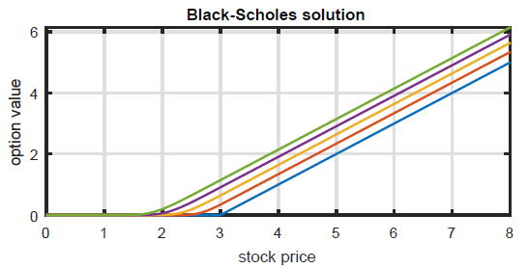
Example: Numerical solution of Black-Scholes
Plot results
If S=2, then little chance it will reach strike price K=3; low value
If S=3, then value is higher

Slide 17
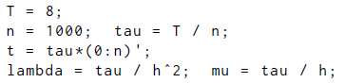
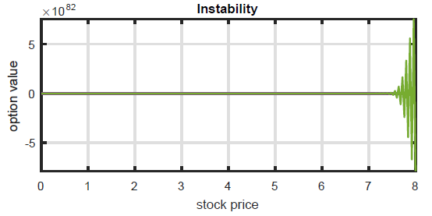
Example: Numerical solution of Black-Scholes
Now extend simulate to $T=8$ (loops not shown)
This makes no sense: look at the scale on the ordinate!
The numerical method is unstable, we need better

Slide 18
Section 11.2 The method of lines

Slide 19
The method of lines
In the last section, we used a simple method that worked depending on the choice of parameters
We want to put this method into a general framework that can be understood via analyzing the methods
This will very often avoid the need to make careful parameter choices to make a method work
This general framework is called the method of lines, but it is really a family of methods.

Slide 20
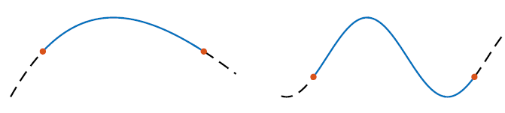
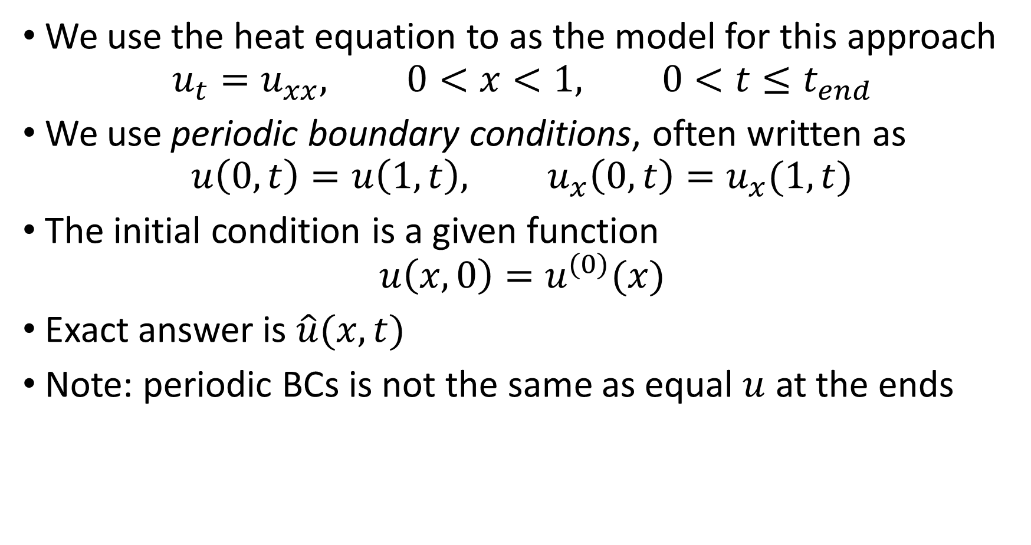
The method of lines
We use the heat equation to as the model for this approach
$$u_{t}=u_{xx}, 0<x<1, 0<t≤t_{end}$$
We use periodic boundary conditions, often written as
$$u\left(0,t\right)=u\left(1,t\right), u_{x}\left(0,t\right)=u_{x}(1,t)$$
The initial condition is a given function
$$u\left(x,0\right)=u^{(0)}(x)$$
Exact answer is $\hat{u}(x,t)$
Note: periodic BCs is not the same as equal $u$ at the ends

Slide 21
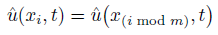
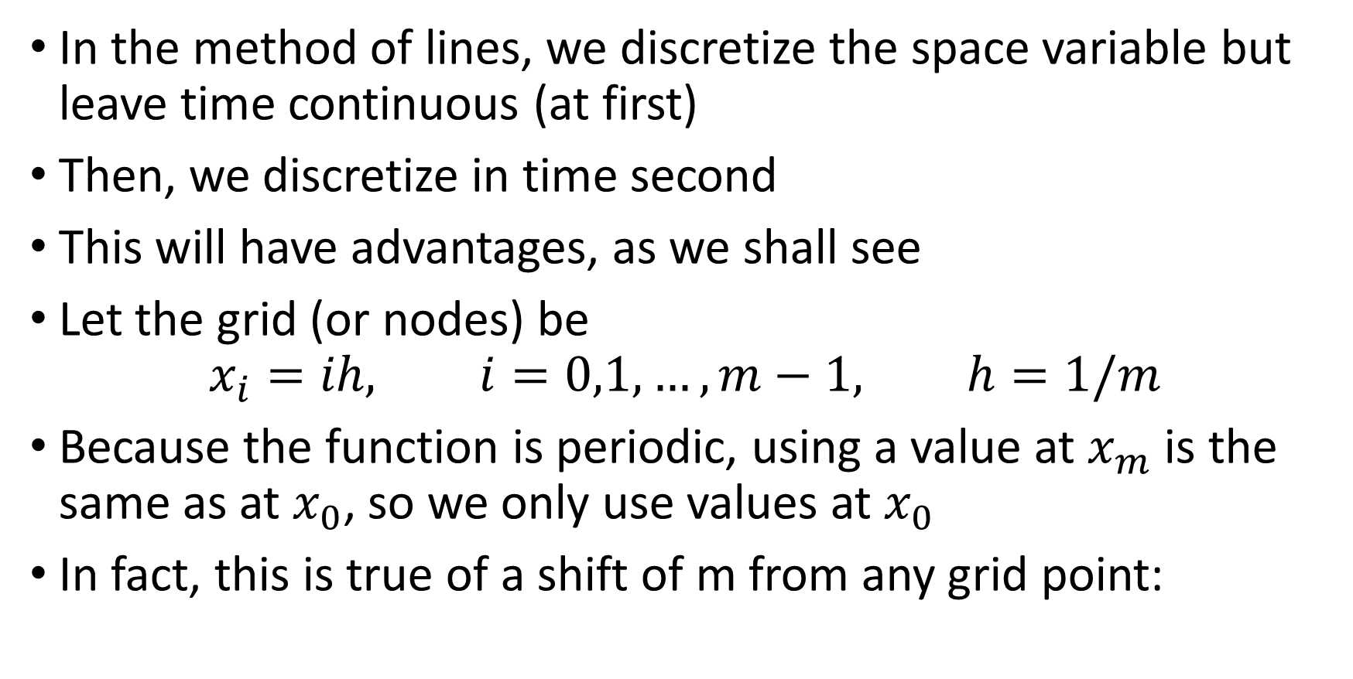
The method of lines
In the method of lines, we discretize the space variable but leave time continuous (at first)
Then, we discretize in time second
This will have advantages, as we shall see
Let the grid (or nodes) be
$$x_{i}=ih, i=0,1,…,m−1, h=1/m$$
Because the function is periodic, using a value at $x_{m}$ is the same as at $x_{0}$, so we only use values at $x_{0}$
In fact, this is true of a shift of m from any grid point:

Slide 22
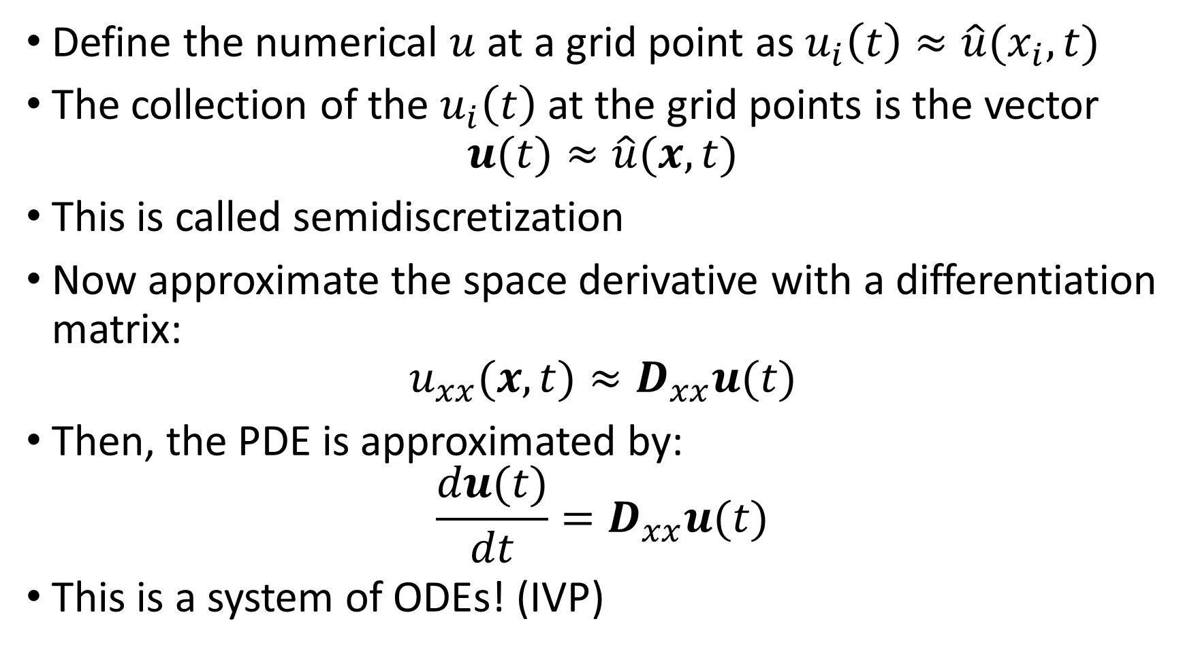
The method of lines
Define the numerical $u$ at a grid point as $u_{i}\left(t\right)≈\hat{u}(x_{i},t)$
The collection of the $u_{i}\left(t\right)$ at the grid points is the vector
$$u(t)≈\hat{u}(x,t)$$
This is called semidiscretization
Now approximate the space derivative with a differentiation matrix:
$$u_{xx}(x,t)≈D_{xx}u(t)$$
Then, the PDE is approximated by:
$$\frac{du(t)}{dt}=D_{xx}u(t)$$
This is a system of ODEs! (IVP)

Slide 23
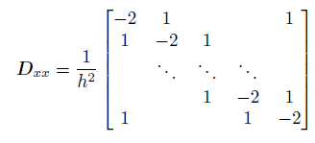
The method of lines
To approximate the space derivative, we need a periodic version of the differentiation matrix:
The difference with the previous version is the nonzero elements in upper right and lower left: wrapping of u values around the end
See Function 11.2.1 (diffper.m); very similar to before

Slide 24
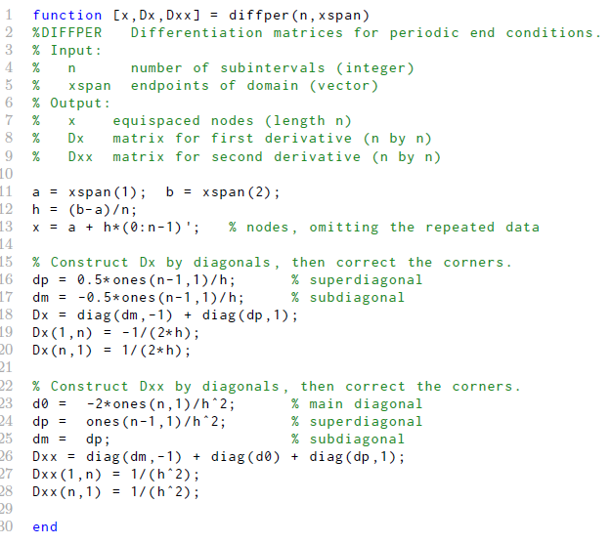

Slide 25
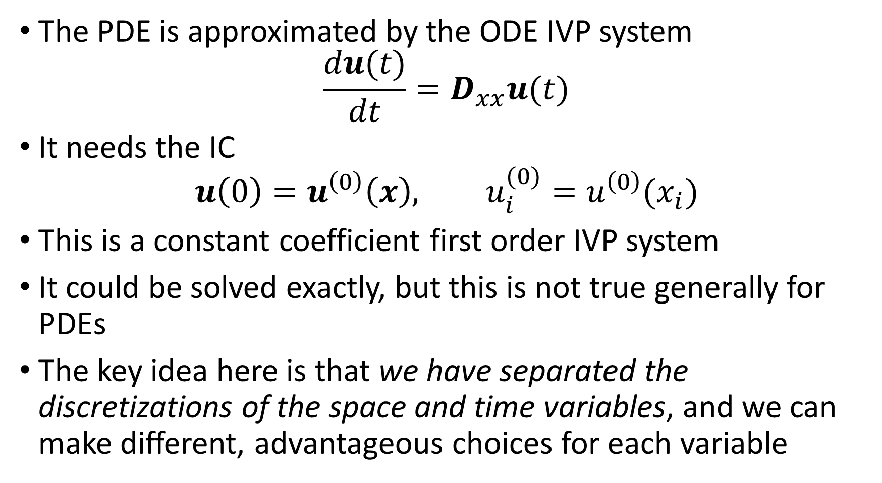
The method of lines
The PDE is approximated by the ODE IVP system
$$\frac{du(t)}{dt}=D_{xx}u(t)$$
It needs the IC
$$u\left(0\right)=u^{\left(0\right)}\left(x\right), u_{i}^{(0)}=u^{\left(0\right)}(x_{i})$$
This is a constant coefficient first order IVP system
It could be solved exactly, but this is not true generally for PDEs
The key idea here is that we have separated the discretizations of the space and time variables, and we can make different, advantageous choices for each variable

Slide 26
The method of lines
The PDE is approximated by the ODE IVP system
$$\frac{du(t)}{dt}=D_{xx}u(t)$$
It needs the IC
$$u\left(0\right)=u^{\left(0\right)}\left(x\right), u_{i}^{(0)}=u^{\left(0\right)}(x_{i})$$
This is a constant coefficient first order IVP system
It could be solved exactly, but this is not true generally for PDEs
The key idea here is that we have separated the discretizations of the space and time variables, and we can make different, advantageous choices for each variable

Slide 27
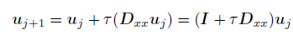
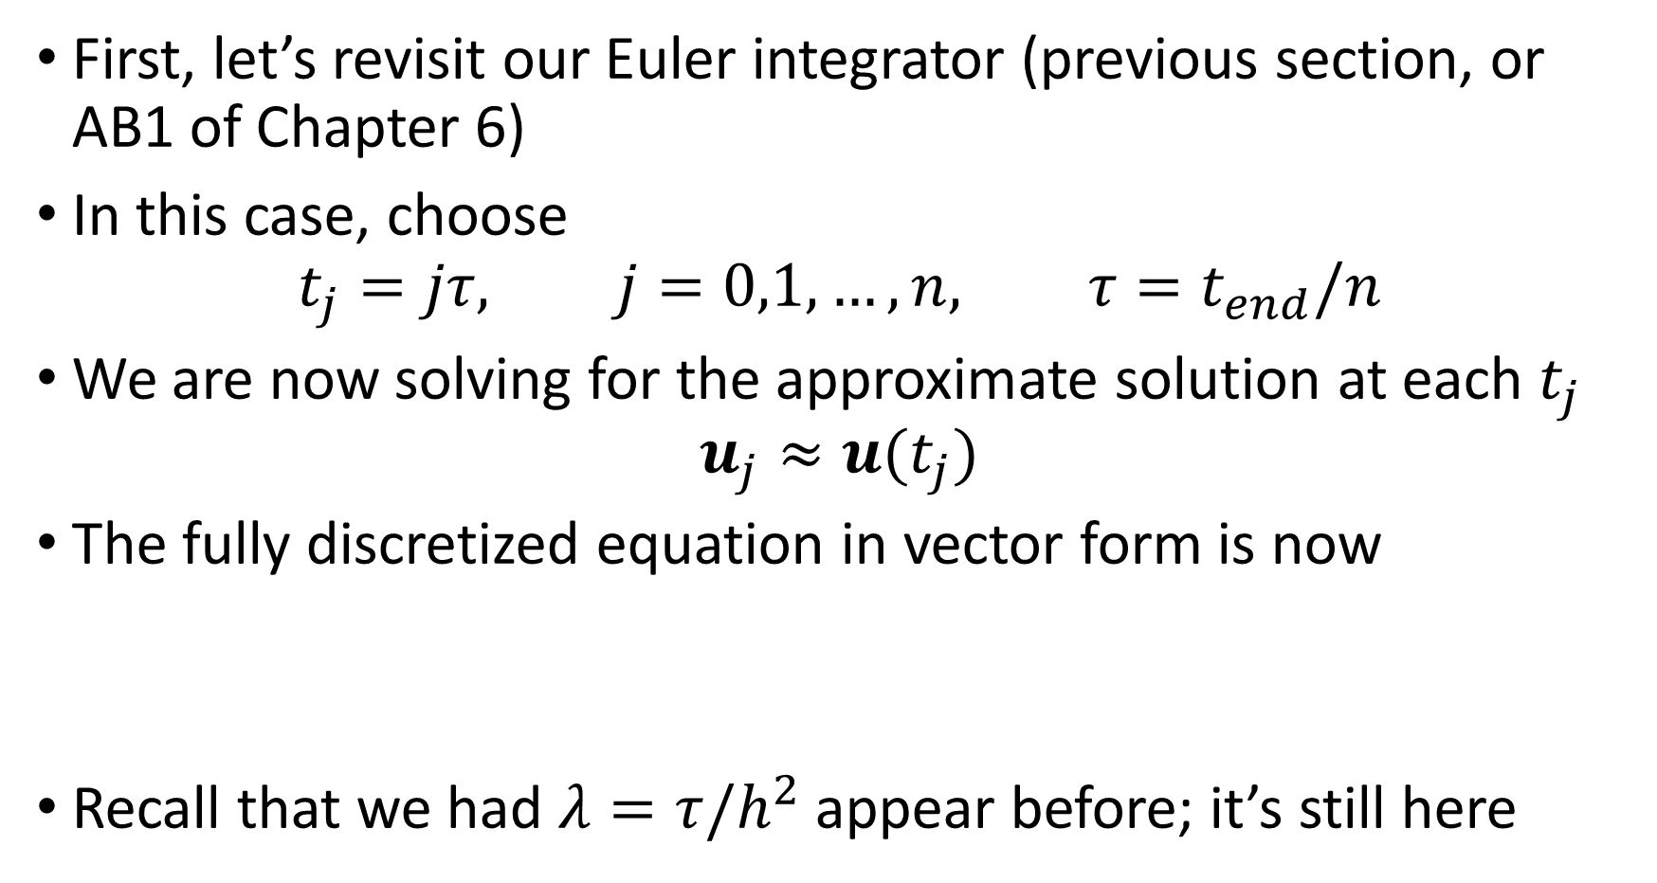
The method of lines
First, let’s revisit our Euler integrator (previous section, or AB1 of Chapter 6)
In this case, choose
$$t_{j}=jτ, j=0,1,…,n, τ=t_{end}/n$$
We are now solving for the approximate solution at each $t_{j}$
$$u_{j}≈u(t_{j})$$
The fully discretized equation in vector form is now
Recall that we had $λ=τ/h^{2}$ appear before; it’s still here

Slide 28
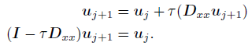
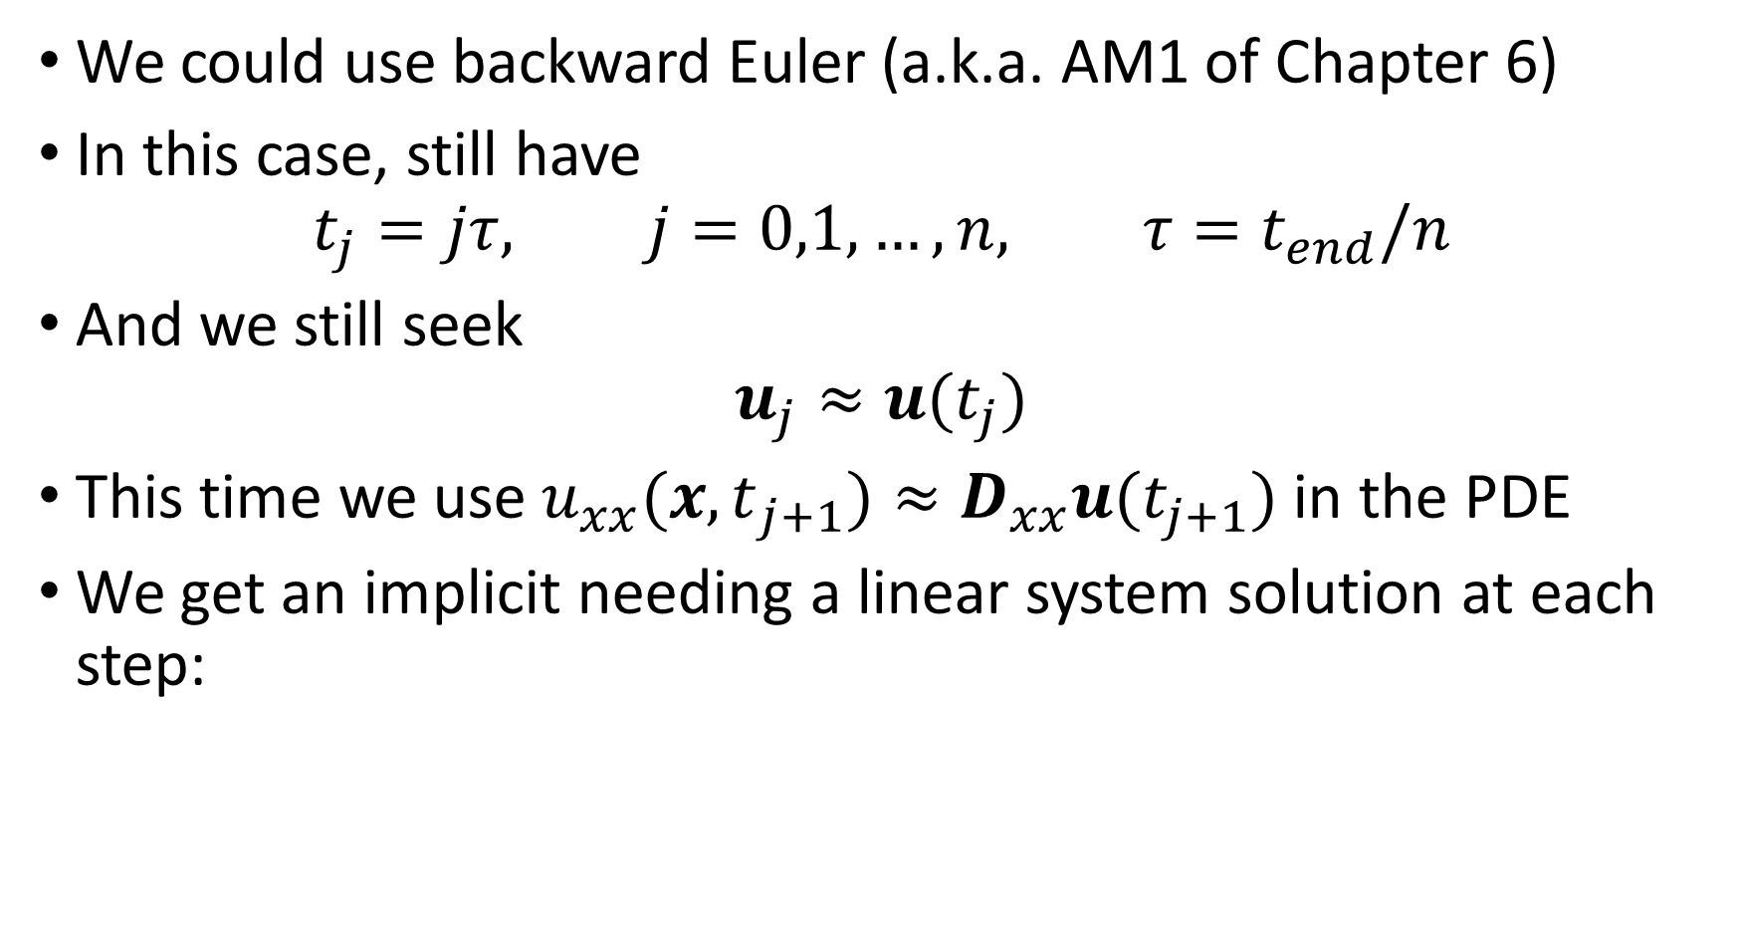
The method of lines
We could use backward Euler (a.k.a. AM1 of Chapter 6)
In this case, still have
$$t_{j}=jτ, j=0,1,…,n, τ=t_{end}/n$$
And we still seek
$$u_{j}≈u(t_{j})$$
This time we use $u_{xx}({x,t}_{j+1})≈D_{xx}u(t_{j+1})$ in the PDE
We get an implicit needing a linear system solution at each step:

Slide 29
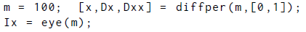
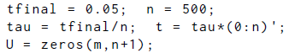
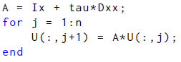
Example: Euler and Backward Euler
Some general setup:
Setup for Euler:
Initial condition; not periodic, but numerically close enough
Apply Euler stepping:

Slide 30
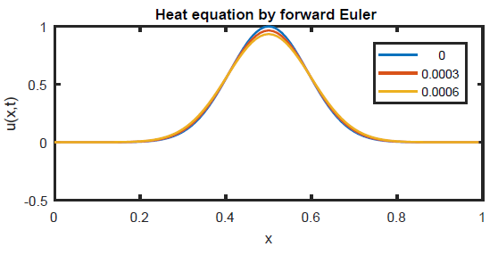
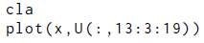
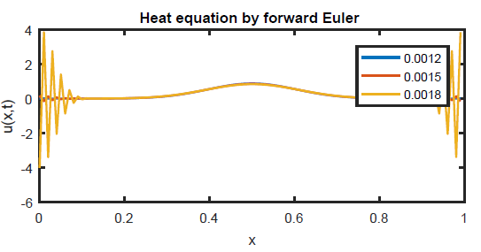
Example: Euler and Backward Euler
Plot some small times:
Looks ok at start
But for larger times, things go haywire
Growth at ends
Grid scale oscillations

Slide 31

Example: Euler and Backward Euler
Explosive growth
Nothing to do with PDE problem: instability!

Slide 32



Example: Euler and Backward Euler
Now try backward Euler
Solve linear system to advance each step:
In matlab:
Stable for same step size!

Slide 33



Example: Built-in time steppers
Now try ode45 for time stepping
Same setup in space:
Using ode45:
Stable!
But lots of time steps:

Slide 34


Example: Built-in time steppers
Now try ode15s for time stepping
Same setup
Using ode15s:
Solution looks same (not shown)
Far fewer time steps:
From properties of time stepping algorithm

Slide 35
Section 11.3 Absolute stability

Slide 36

The method of lines
Applying different time stepping methods to the constant coefficient problem $u’(t)=Au(t)$gave different results
We need to understand this systematically
All of the methods were “zero-stable” in the sense of 6.8 at $τ→0$
Still, we saw empirically that for small nonzero $τ$ there may be instability as $n→∞$
Let’s analyze it

Slide 37


Absolute stability
Let $A$ have the eigenvalue decomposition
$$A=VDV^{−1}$$
Then, we can write
Here $y(t)=V^{−1}u(t)$
Because $D$ is diagonal, the dynamics of the $y$ are completely decoupled
Each row is then just

Slide 38


Absolute stability
This means we can focus on the model problem
$$y^{′}=λy, y\left(0\right)=1$$
$λ$ may be a complex number
The answer is easy:
$$y\left(t\right)=e^{λt}$$
If $λ=α+iβ$, then
Then $y(t)$ is bounded for $t→∞$ iff
This is the left half of the complex $λ$ plane

Slide 39

Stability regions
When an IVP method with step size $τ$ is applied to our model problem, the solution is bounded as $t→∞$ only for some values of $τ$ and $λ$
Example: Euler and Backward Euler
Apply Euler discretization to
$$y^{′}=λy, y\left(0\right)=1$$
One gets
$$y_{k+1} =y_{k}+τ\left(λy_{k}\right),=\left(1+τλ\right)y_{k}$$
Let $ς=τλ$
At any time $t_{k}$, $y_{k}={\left(1+ς\right)}^{k}$, and then $|y_{k}|={\left|1+ς\right|}^{k}$

Slide 40

Example: Euler and Backward Euler
To keep the solution bounded, we need decay
We must have $\left|1+ς\right|≤1$
For complex $ς$, we can think of this as follows:
$$\left|ς+1\right|=\left|ς−(−1)\right|≤1$$
This is region inside closed unit disk centered at (-1,0)
Staying inside it gives stability
If we repeat for backward Euler, we get
$$y_{k+1} =y_{k}+ςy_{k+1}, or {y_{k+1}=\left(1−ς\right)}^{−1}y_{k}$$
We get absolute stability iff ${\left|1−ς\right|}^{−1}≤1$ or $\left|ς−1\right|≥1$
This is region outside open unit disk centered at (1,0)

Slide 41
Stability regions
This means we can focus on the model problem
$$y^{′}=λy, y\left(0\right)=1$$
$λ$ may be a complex number
The answer is easy:
$$y\left(t\right)=e^{λt}$$
If $λ=α+iβ$, then
Then $y(t)$ is bounded for $t→∞$ iff
This is the left half of the complex $λ$ plane

Slide 42

Stability regions
These are regions of absolute stability, or stability regions
It turns out that for all RK and multistep methods, just as in our example, that the only parameter that matters is
$$ς=τλ$$
The answer will be bounded iff $ς$ is within some subset of the complex plane
These can be computed from the requirement that growth cannot occur
Here are some results for those stability regions for the model problem $y^{′}=λy, y\left(0\right)=1$

Slide 43

Stability regions: Adams-Bashforth
Explicit mutli-step method
Orders 1 to 3
Closed region inside the curves is stable

Slide 44

Stability regions: Adams-Moulton
Implicit multi-step method
Orders 2 to 6
Closed region inside the curves is stable
Region of stability is bigger than AB methods

Slide 45

Stability regions: Backward differentiation formulas
Implicit multi-step method
Orders 1 to 6
Closed region outside the curves is stable
Orders 1 and 2 stable for entire left half plane
Parts of imaginary axis excluded

Slide 46

Stability regions: Runge-Kutta methods
Explicit, multi-stage single-step methods
Orders 1 to 4
Closed region inside the curves is stable
Stable for parts of imaginary axis

Slide 47

Stability regions
For any particular method and value of $λ$, we can use the stability region to deduce which, if any, values of $τ$ will give a bounded solution
Example: Euler method
Suppose we apply Euler discretization to
$$y^{′}=λy, y\left(0\right)=1$$
Also suppose $λ=−4$
Then $ς=τλ=−4τ$ is only on the negative real axis
We need $ς∈[−2,0]$ for stability
So we need $ς≥−2$ or $τ≤\frac{1}{2}$ for stability

Slide 48

Example: Euler method
Now suppose $λ=i$
Then $ς=τλ=iτ$, which is only on positive imaginary axis
But no part other than the origin is in the region of stability!
(Forward) Euler will not be stable for any positive $τ$
Backward Euler is different; the whole imaginary axis is in the region of stability
So, any choice $τ$ will be stable

Slide 49

Stability regions
The last example does not contradict our earlier statements
Those earlier statements were based on $τ→0$ for $t∈[a,b]$
Both that limit and the limit $t→∞$ imply that the number of steps $n→∞$
But the limits behave differently
Two important trends to remember:
As the order of accuracy increases, the stability regions get smaller.
Implicit methods have larger stability regions than the corresponding explicit method.
Explains differences between ode45 (explicit)and ode15s (implicit)

Slide 50




Stability and the heat equation
Consider Euler for heat equation first

Slide 51

Stability and the heat equation
Here’s the stability region

Slide 52




Stability and the heat equation
Now find the biggest $τ$ where all $τλ>2$
Use it

Slide 53


Stability and the heat equation
Now backward Euler; we need $\left|ς−1\right|≥1$
All $ς=τλ$ values are on the negative real axis for any $τ>0$
Illustrated with same values as Euler

Slide 54


Stability regions
For the matrix $D_{xx}$ that we used, the eigenvalues can be computed exactly
If $h=1/m$, then the eigenvalues are given by
The eigenvalues lie within $[−4m^{2},0]$
For Euler method, this means we need a small time step:
For backward Euler, any $τ>0$ will do: it is unconditionally stable for this problem

Slide 55

Stability regions
Stability is essential for a numerical solution of the problem
Stability only means that the error does not grow exponentially
However, both Euler and backward Euler have $O(τ)$ accuracy in time
To get accurate answers, both would require small steps
But backward Euler allows for a wider range of $h$ that avoids exponentially large nonsense

Slide 56
Section 11.4 Stiffness

Slide 57

Stiffness
The PDE $u_{t}=u_{xx}$ was approximated by the ODE IVP system
$$\frac{du(t)}{dt}=D_{xx}u(t)$$
The eigenvalues of $D_{xx}$ ranged from 0 to about $−4/h^{2}$
This meant that any explicit scheme needs $τ=O\left(h^{2}\right)$ as
$h→0$ for stability
After diagonalization, we found that we had each element decaying rapidly:
$$y_{j}^{′}=λ_{j}y_{j} ⇒y_{j}=c_{j}e^{−t|λ_{j}|}$$
We can consider $1/|λ_{j}|$ as a time scale for that solution component

Slide 58

Stiffness
The semidiscrete system has many eigenvalues from $D_{xx}$
$$\frac{du(t)}{dt}=D_{xx}u(t)$$
Thus it has different time scales in the answer, generally
Using the eigenvalues, scales from $O(1)$ to $O(m^{−2})=O\left(h^{2}\right)$
The $j=0$ eigenvalue is for any steady state component and is treated separately

Slide 59

Stiffness
To capture the longest finite time scale, which is $O(1)$, three things happen as $h→0$:
The spatial discretization becomes more accurate like $O\left(h^{2}\right)$
The size of the (sparse) matrix increases like $O\left(h^{−1}\right)$
If we use an explicit time stepping method, then absolute stability requires $O\left(h^{−2}\right)$ time steps
As $h→0$, the number of time steps can become very burdensome
This is why implicit methods are preferred for the heat equation

Slide 60

Stiffness
Problems that have multiple time scales that differ by orders of magnitude (or orders of $h$) are called stiff.
It is important to note that stiffness is not a binary condition but a spectrum
Problems with very similar time scales are certainly not stiff, but problems that have 10 or 100 times different scales may be
Problems with 1000 times different time scales almost certainly are stiff.
Implicit stepping often required for this kind of problem

Slide 61

Linearization
All this talk of linear problems is great, but what about nonlinear problems?
It turns out that the link to our previous discussion absolute stability comes through linearization about the exact answer
Consider the ODE problem
$u’=f(u,t)$for $u(t)$
Perturbations, such as roundoff error, are always present
If the exact solution is $\hat{u}(t)$, then adding a small perturbation $v(t)$ results in $\hat{u}\left(t\right)+v(t)$
Substitute in the ODE…

Slide 62



Linearization
For small $v(t)$, we can carry out a multidimensional Taylor expansion (2nd line) to arrive at
The Jacobian matrix $J(t)$ is matrix of first derivatives of $f$
This is the linearization of the ODE

Slide 63

Linearization
We make one more simplification
“Freeze” the Jacobian at $t_{∗}$ , the time when the linearization is performed (or the perturbation added)
We then use a constant coefficient matrix $A=J(t_{∗})$
The linearized system is then $v’=Av$
This brings us back to a linear system

Slide 64


Slide 65
Linearization
While we have made link back to a linear system, it is only an approximation to the nonlinear problem
It does give us insight however.
Rule of thumb for absolute stability: The eigenvalues of the Jacobian appearing in the linearization about an exact solution, after scaling by the time step , must lie in the stability region of the IVP solver.
This is only a rule of thumb because of those approximations, but it is a good one

Slide 66


Oregonator and linearization
Define constants, then they are used in three-component function
ode15s is fast

Slide 67

Oregonator and linearization
The dots indicate times with solution values
More where the solution changes rapidly: most disparate scales there?

Slide 68



Oregonator and linearization
ode45 is slower and uses many more time steps
What can the Jacobian tell us?
Around $t=1/2$, the time scales differ by roughly 1000

Slide 69



Oregonator and linearization
Use these to check with RK4 stability criterion for $t=1/2$
First: stability criterion
Second: actual choice

Slide 70



Oregonator and linearization
Use these to check with RK4 stability criterion around $t=4$
Smaller eigenvalues between 0 and -1
First: stability criterion
Second: actual choice

Slide 71

A-stability
For our model problem $y^{′}=λy$, we found that two methods that were stable for the whole left half plane: AM1 and AM2 (or backward Euler and BDF2, respectively)
When this happens, the method is A-stable
If this only happens in a sector of angle in either direction from the negative real axis, then the method is called A($α$)-stable
The trapezoidal method is also A-stable

Slide 72

A-stability
This is great, but can we get higher order A-stable methods?
Can we get higher order A-stable methods?
Unfortunately, the answer is no.
Trapezoidal and BDF are the best we can do
RK methods similar; no details

Slide 73
Section 11.5 Method of lines for parabolic PDEs

Slide 74


Method of lines
We want to extend the method of lines approach to include boundary conditions and nonlinearity
The PDE we consider is of the form
The general form for the boundary conditions are
The $α_{i}, β_{i}, γ_{i}$ are known
constants

Slide 75


Boundary conditions first
We need to include the boundary values in the discretization
First, the grid points
$$x_{0}=a,x_{1},…,x_{m−1,}x_{m}=b$$
We consider unknowns at endpoints and interior points separately:

Slide 76



Boundary condition removal
After approximating space derivatives using $D_{x}$ and $D_{xx}$, we will have a set of ODEs for the interior unknowns:
For this system, the boundary values get used in $f$
We can use $D_{x}$ to discretize the boundary conditions (really use only first and last rows):

Slide 77


Boundary condition removal
Solve the system for the two boundary values:
For Dirichlet conditions, $B=I$ and $C=0$
Otherwise, B and C more complicated, but known
Let’s do an example…

Slide 78


Example: boundary removal
Recall the Black-Scholes problem:
$$−u_{t}+\frac{1}{2}σx^{2}u_{xx}+rxu_{x}−ru=0$$
$$u\left(0\right)=0, u_{x}\left(S_{max}\right)=1$$
For the left BC, this means $u_{0}=0$
For the right BC, use the one-sided difference formula

Slide 79


Example: boundary removal
Consider interior points as known.
Use $u_{0}=0$ and
Write the system for $u_{0}$ and $u_{m}$:
Note that $v={\left[u_{1} … u_{m−1} \right]}^{T}$
Numbering will be shifted in Matlab

Slide 80


Example: boundary removal 2
Consider using the Chebyshev matrix for $D_{x}$
Still have $u_{0}=0$
For the derivative at the right end,
Write the system for $u_{0}$ and $u_{m}$ again:

Slide 81



Implementation
How to use this with the ODE for the interior points?
Here’s how:

Slide 82

Implementation
To extend from interior unknowns $v$ to all unknowns $u$, use a function called extend in matlab
Appends boundary values onto $v$
To remove the endpoints, use a function called chop
Simply drop endpoints $u(2:m)$
We’ll use ode15s to solve the ODE system

Slide 83

Example: heat equation
Consider
$$u_{t}=u_{xx}, −1<x<1$$
$$u\left(−1,t\right)=0, u\left(1,t\right)=2$$
$$u\left(x,0\right)=1+\sin{\frac{πx}{2}}+3\left(1−x^{2}\right)e^{−4x^{2}}$$
In matlab: setup, add bcs, remove bcs
Now ready to solve…

Slide 84


Example: heat equation
Define rhs of ODE
IC and call solver
Put on BCs and plot

Slide 85


Example: heat equation
Exponential bump decays faster than sinusoidal part
What is long time solution? (that is, for
$t→∞$)
Nearing that?

Slide 86


Example: nonlinear heat equation
Consider
$$u_{t}=u_{xx}+u^{2}, −1<x<1$$
$$u\left(−1,t\right)=0, u\left(1,t\right)=0$$
$$u\left(x,0\right)=6\left(1−x^{2}\right)e^{−4{(x−0.5)}^{2}}$$
Use Chebyshev matrices for differentiation now
Nonlinear PDE now, but the process is the same

Slide 87




Example: nonlinear heat equation
Setup first
Modified function
IC then solver
Extend to boundary, plot

Slide 88

Example: nonlinear heat equation
Source causes solution values to increase with time

Slide 89

Example: Black-Scholes
Recall the Black-Scholes problem:
$$−u_{t}+\frac{1}{2}σx^{2}u_{xx}+rxu_{x}−ru=0$$
$$u\left(0\right)=0, u_{x}\left(S_{max}\right)=1$$
Unstable case for Euler method, finite difference method
Right BC:

Slide 90



Example: Black-Scholes
Right BC value
ODE system, variable coeffs

Slide 91

Example: Black-Scholes
Stable now

